Slide 1

MASTERS OF COMPUTER APPLICATIONS
UNIVERSITY INSTITUTE OF TECHNOLOGY
RAJIV GANDHI PRODYOGIKI VISHWAVIDHYALAYA
A
MAJOR PROJECT ON
FACIAL EMOTION DETECTION
SUBMITTED BY:
CHETNA SHARMA
(0101CA211015)

Slide 2
CONTENTS
What Is Facial Emotion Detection?
How Does It Work?
Convolution Neural Network
Keras Library
OpenCV
Training The Model
Flow Chart
Images Of Seven Different Emotions
Applications Of Facial Emotion Detection
Future Of Facial Emotion Detection
Conclusion

Slide 3

What Is Facial Emotion Detection?
Facial Emotion Detection is a technology
that allows computers to identify human emotions based on facial expressions.
This technology has been developed to improve communication between human and machines .
Facial emotion detection technology uses AI algorithms to detect and analyze facial expressions . This technology is used in various fields such as healthcare, education, entertainment and security.

Slide 4

HOW DOES IT WORK?
Facial emotion detection technology works by analyzing the different Facial features and expressions and map them to specific emotions .The technology can detect several emotions such as happiness , sadness , Anger , surprise, fear and disgust.
It can also detect micro expressions that
are difficult to identify with your eye. Facial emotion detection can be made with the help of machine learning , we can use cnn and keras to build a model.

Slide 5
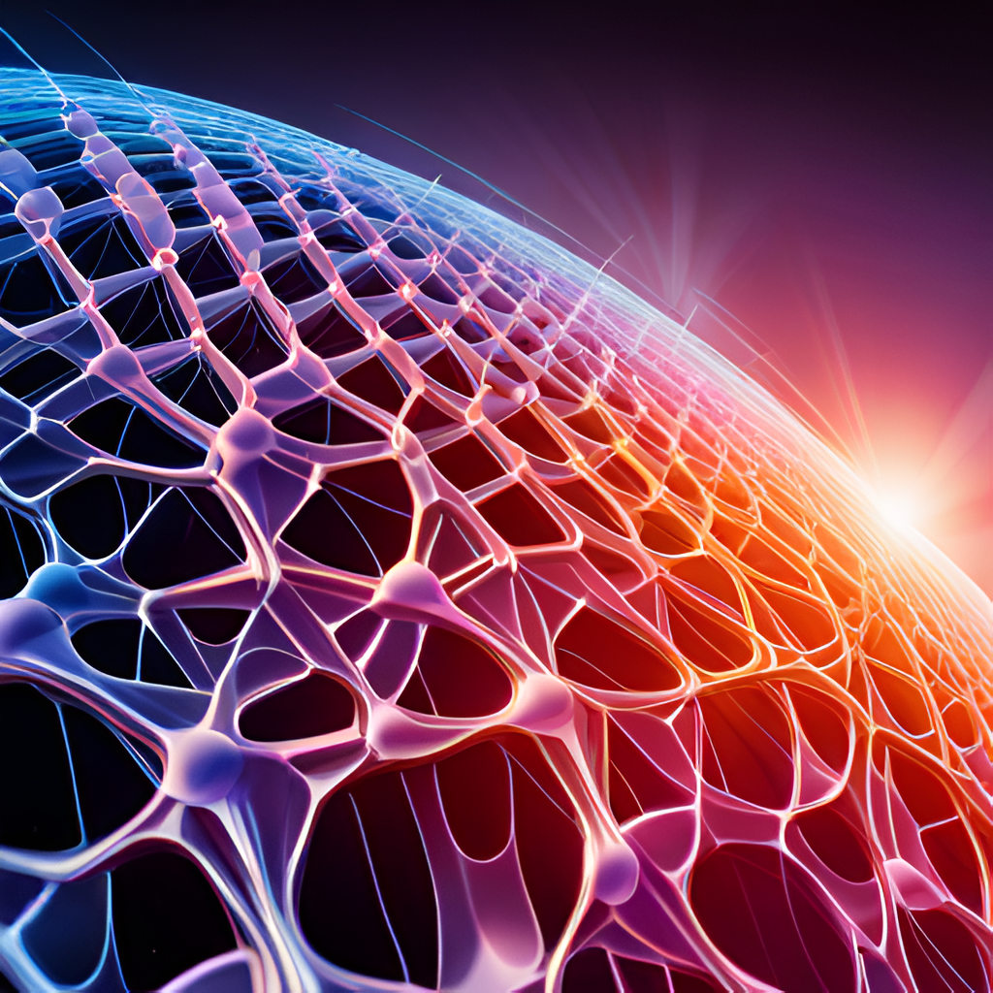
CONVOLUTIONAL NEURAL NETWORK
CNNs are a type of deep learning algorithm that are commonly used for image analysis tasks. They are particularly well-suited for facial emotion detection because they can learn to identify patterns in images at different levels of abstraction.
A CNN consists of multiple layers, each of which performs a specific function in the analysis of an image. The first layer is typically a convolutional layer, which applies a set of filters to the input image to extract features such as edges and corners.

Slide 6

KERAS LIBRARY
Keras is a popular open-source library for building and training deep learning models. It provides a high-level interface for defining and running neural networks, making it easy to experiment with different architectures and hyperparameters.
One of the key advantages of Keras is its support for GPU acceleration,which allows models to be trained much faster than on a CPU. This is particularly important for facial emotion detection, which requires large amounts of data and computationally intensive training.

Slide 7

OPENCV
OpenCV is the huge open-source library for the computer vision, machine learning, and image processing and now it plays a major role in real-time operation which is very important in today’s systems.
By using it, one can process images and videos to identify objects, faces, or even handwriting of a human. When it integrated with various libraries, such as NumPy , python is capable of processing the OpenCV array structure for analysis. To Identify image pattern and its various features we use vector space and perform mathematical operations on these features.

Slide 8

TRAINING A MODEL
To train a model for facial emotion detection, a large dataset of labeled images is required. The dataset should include images of people expressing a range of emotions, as well as neutral images for comparison.
Once the dataset has been prepared, a CNN can be trained using Keras. The model is typically trained using a technique called backpropagation, which adjusts the weights of the network to minimize the difference between the predicted and actual labels.

Slide 9
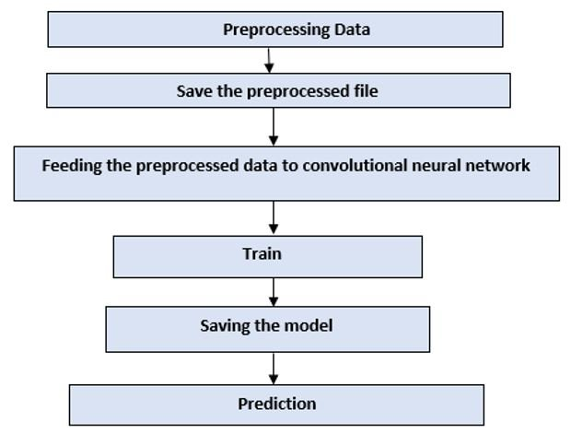
FLOW CHART

Slide 10
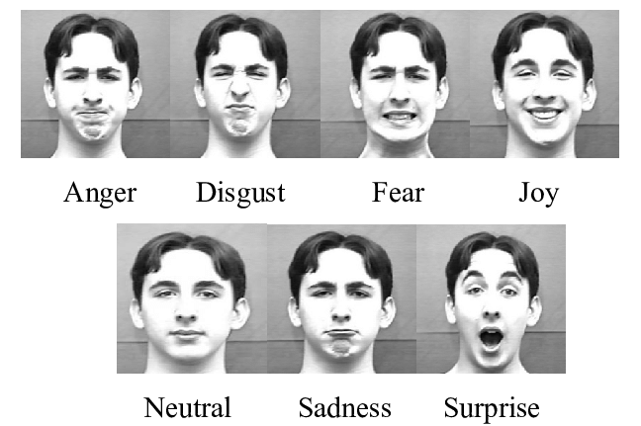
IMAGES OF SEVEN DIFFERENT EMOTIONS

Slide 11

APPLICATIONS OF FACIAL EMOTION DETECTION
1. In healthcare ,it can also be used to detect early signs of depression, anxiety, and other mental health issues.
2. In education, It can be used to assess students engagement levels and adjust teaching methods accordingly.
3.In the entertainment industry ,It can be used to create more immersive experiences for viewers and gamers.
4.In security ,It can be used to detect suspicious behaviour and prevent crime.

Slide 12
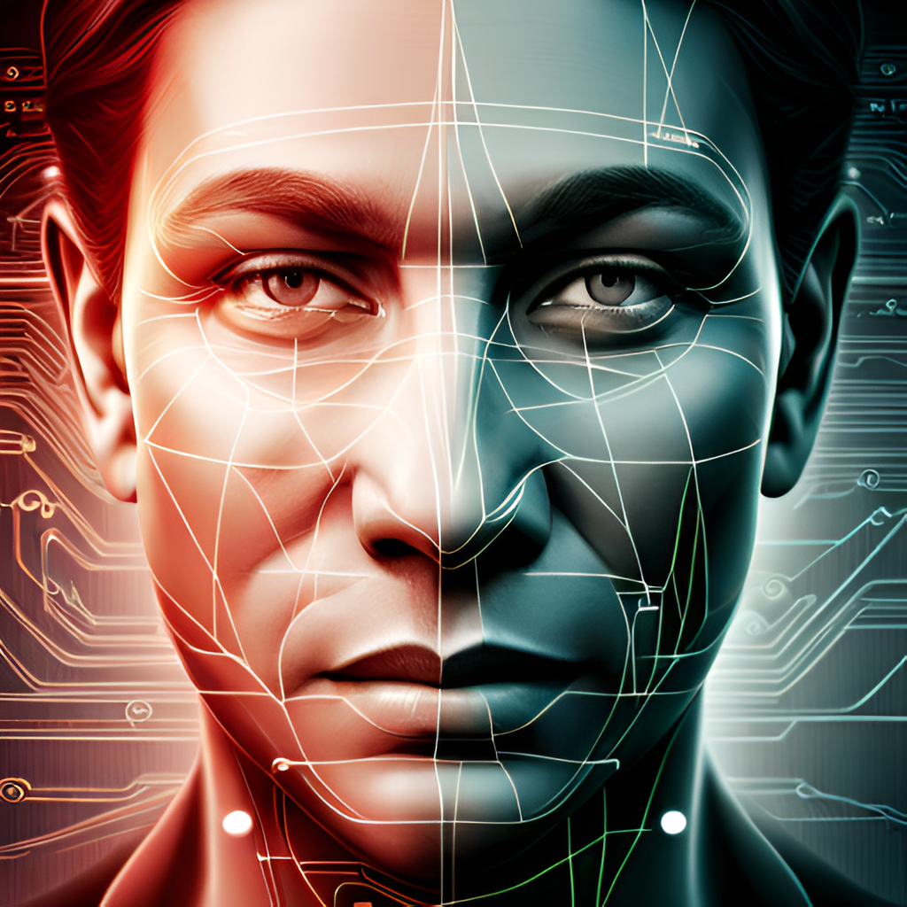
FUTURE OF FACIAL EMOTION DETECTION
As facial emotion detection technology continues to evolve, we can expect to see even more advanced applications in the future. For example, this technology could be used to create more immersive virtual reality experiences by analyzing a user's facial expressions and adjusting the environment accordingly.
There is also potential for facial emotion detection to be integrated with other technologies, such as voice recognition and biometric authentication, to create more seamless and intuitive user experiences.

Slide 13

CONCLUSION
In conclusion, facial emotion detection using CNNs and Keras is a promising area of research that has the potential to revolutionize fields such as psychology, marketing, and human-computer interaction.
Facial emotion detection technology is a promising development in the field of artificial intelligence. It has numerous applications in different fields and has the potential to improve communication between humans and machines.

Slide 14
THANK YOU

